Slide 1
Kotlin Introduction
Tim Teaching

Slide 2
Contents
What is Kotlin
Why is Kotlin
Syntax
Output
Comments
Variables
Data Types
Operators
Conditions
Loop
Functions

Slide 3
What is Kotlin?
Kotlin is a modern, trending programming language.
Released 2016 by JetBrains
- Become very popular since it is compatible with Java
Kotlin is used for:
Mobile applications (specially android apps)
Web development
Server side applications
Data science
And much, much more!

Slide 4
Why Use Kotlin?
- Fully compatible with Java
- Works on different platforms (Windows, Mac, Linux, Raspberry Pi, etc.)
- Concise and safe
- Easy to learn, especially if you already know Java
- Free to use
- Big community/support

Slide 5
Kotlin IDE
Intellij IDEA https://www.jetbrains.com/idea/download/
Visual Studio Code https://code.visualstudio.com/
Playground https://play.kotlinlang.org/
Etc.

Slide 6
fun main() {
print("Hello World")
}

Slide 7
Kotlin Syntax
fun keyword is used to declare a function.
A function is a block of code designed to perform a particular task
The main() function is used to execute code.
Any code inside the main() function's curly brackets {} will be executed.

Slide 8

Kotlin Output
fun main() {
print("Hello World")
println("")
print("Saya sedang berhitung: 3 + 3 = ")
println(3+3)
println("It is awesome!")
}

Slide 9
Kotlin Comments
Single-line comments starts with two forward slashes (//)
Multi-line comments start with /* and ends with */.
// print("baris ini tidak akan dieksekusi")
/*println("baris ini tidak dieksekusi")
println("baris ini juga tidak dieksekusi")*/

Slide 10
Kotlin Variables
use var or val, and assign a value to it with the equal sign (=)
var variables can be changed
val variables cannot be changed
variables in Kotlin do not need to be declared with a specified type (like "String" for text or "Int" for numbers
var name = "John"
var birthyear = 2000
println(name)
println(birthyear)

Slide 11
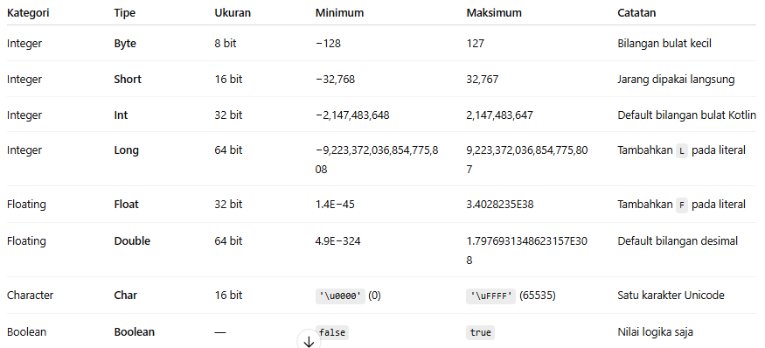
Kotlin Data Types

Slide 12
val myNum: Int = 5 // Int
val myDoubleNum: Double = 5.99 // Double
val myLetter: Char = 'D' // Char
val myBoolean: Boolean = true // Boolean
val myText: String = "Hello" // String
// convert numeric data types
val x: Int = 5
val y: Long = x.toLong()
println(y)

Slide 13
Kotlin Operators
Arithmetic Operators (operator matematika)
Assignment Operators (operator penugasan)
Comparison Operators (operator perbandingan)
Logical Operators (operator logika)

Slide 14
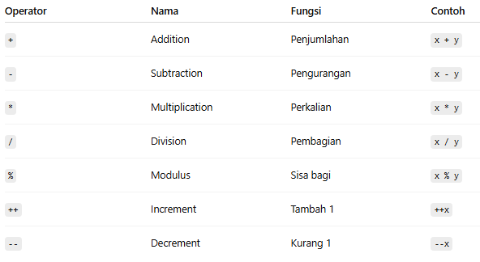
Arithmetic Operators

Slide 15
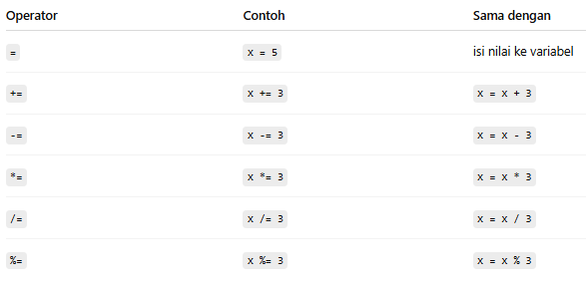
Assignment Operators

Slide 16
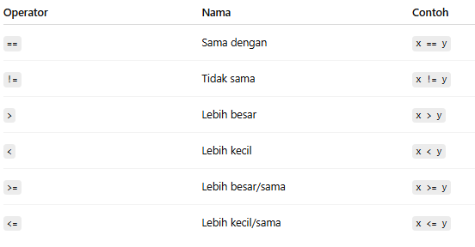
Comparison Operators

Slide 17
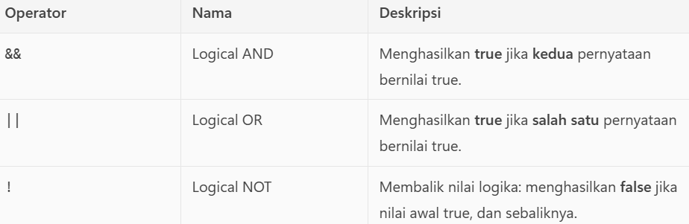
Logical Operators

Slide 18
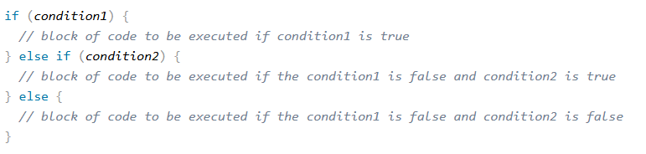
Conditions

Slide 19
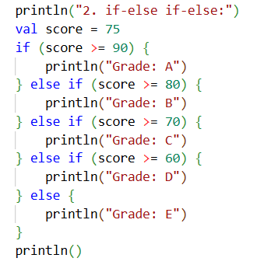


Slide 20
Loop
When
While Loop
Do While
For Loop

Slide 21
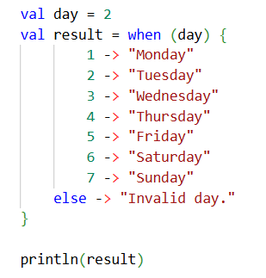
When

Slide 22

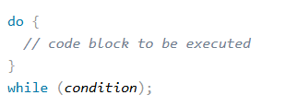
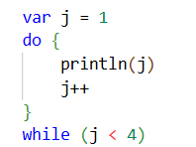
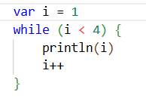
While Loop

Slide 23
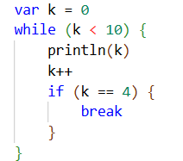
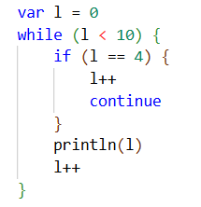
Break and Continue

Slide 24
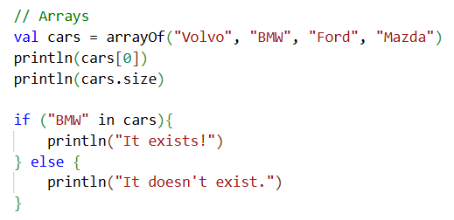

Arrays
Arrays are used to store multiple values in a single variable, instead of creating separate variables for each value.

Slide 25
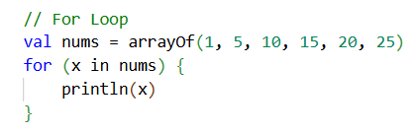

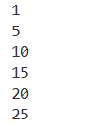

For Loop

Slide 26
Functions
a block of code which only runs when it is called
functions are used to perform certain actions, and they are also known as methods.
fun myfunction() {
println("I am learning kotlin")
}
fun main() {
myFunction() // Call myFunction
}
fun greeting(fname: String){
println("Welcome " + fname)
}
fun main() {
greeting(“Joko Susilo”)
}

